Slide 1


PRINCIPLE COMPONENT ANALYSIS
PRESENTED TO
Sukanya Ma’am
PRESENTED BY
Akshay
Sanika
Atharva
Khushi
Dimensionality Reduction
13/10/2023

Slide 2

1
Data Compression
2
Noise Reduction
Objectives
3
Data Preprocessing
4
Anomaly Detection
5
Feature Extraction
6
Improved Model
Performance
7
Reduced Dimensionality

Slide 3

INTRODUCTION
Principal Component Analysis (PCA) is a popular technique used
for dimensionality reduction in data analysis and machine learning.
It works by transforming the original data into a new coordinate
system, where the data's variance is maximized along the axes.
The idea is to reduce the number of features or dimensions
while retaining as much of the original data's variance as possible.

Slide 4
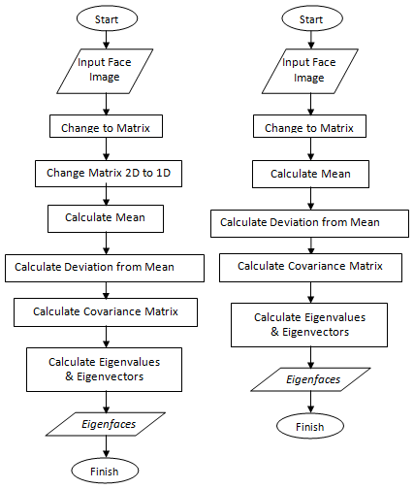

This flowchart outlines the main steps involved in PCA. It begins with data preprocessing, standardizing or normalizing the data, and then progresses to the calculation of the covariance matrix. Next, PCA calculates the eigenvalues and eigenvectors, which are used to select the principal components based on your criteria (e.g., explained variance). The data is then projected into the new subspace created by these selected components, effectively reducing dimensionality. Reconstruction is optional and can be used to transform the reduced-dimension data back into the original feature space if necessary.
FLOWCHART

Slide 5

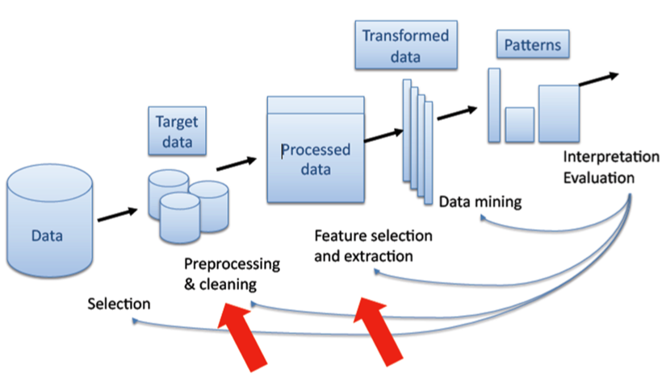

Data Preprocessing
PCA starts with a dataset that typically consists of a matrix where each row represents an observation or data point, and each column represents a feature or variable. It's essential to standardize or normalize the data to have a mean of 0 and a standard deviation of 1. This step ensures that all features are on the same scale and prevents one feature from dominating the analysis due to its larger magnitude.

Slide 6
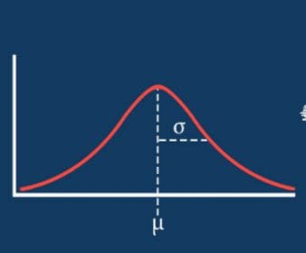
Normalizing Data
Normalizing or standardizing the data is a crucial step in Principal Component Analysis (PCA) to ensure that all variables are on the same scale. This step is necessary because PCA is sensitive to the scale of the variables, and if the data is not standardized, variables with larger scales can dominate the principal components. Here's how you can normalize data for PCA:
Calculate the Mean and Standard Deviation for Each Feature
Standardize Each Data Point
Repeat for All Data Points

Slide 7

Calculations
After standardizing the data, you can proceed with PCA. Here's a step-by-step overview of PCA after data normalization:
Calculate the Covariance Matrix: Compute the covariance matrix of the standardized data. The covariance matrix describes the relationships between variables.
Eigenvalue and Eigenvector Calculation: Calculate the eigenvalues and eigenvectors of the covariance matrix. These represent the directions of maximum variance in the data and the importance of each component.
Select Principal Components: Choose the number of principal components to retain based on your specific criteria, such as the explained variance. This is an important decision in the PCA process.
Projection into the New Subspace: Project the data onto the selected principal components to reduce dimensionality.

Slide 8
Advantages
Efficient Storage and Computation: Smaller datasets resulting from PCA consume less memory and require less computational power, which can be advantageous in resource-constrained environments.
Independence of Principal Components: Principal components are orthogonal, which simplifies interpretation and analysis. Each component captures a different aspect of the data.
Pattern Recognition: PCA can help identify underlying patterns in the data, which can be valuable for various applications, including image and speech recognition.
Decorrelation: PCA transforms the original features into a set of orthogonal (uncorrelated) features. This can be valuable in scenarios where you want to remove interdependencies between variables.
Improved Model Performance: In some cases, reducing dimensionality with PCA can lead to improved model performance because it reduces the complexity of the data and the risk of overfitting.
Anomaly Detection: Anomalies or outliers can be more evident in a lower-dimensional space, making them easier to detect after applying PCA.
Data Preprocessing: PCA can be used as a preprocessing step for various machine learning algorithms, making data more amenable to certain models, especially when the dataset has high dimensionality.

Slide 9
Limitations
Linearity Assumption: PCA assumes that the data is linear, meaning it works best for datasets where the underlying relationships between variables are linear. If the data has non-linear relationships, PCA may not capture the essential structures effectively.
Orthogonal Transformation: PCA transforms data into a new coordinate system in which the principal components are orthogonal (uncorrelated). In some cases, these orthogonal axes might not correspond well to the underlying structure of the data.
Preservation of Variance: PCA aims to maximize the variance in the data along the new principal components. This can lead to a loss of information if the direction of maximum variance doesn't align with the directions of interest in your data.
Sensitivity to Scale: PCA is sensitive to the scale of the variables. If some variables have much larger scales than others, they can dominate the principal components and mask the variability in smaller-scale variables. It's essential to standardize or normalize data before applying PCA.
Loss of Interpretability: Principal components are linear combinations of the original variables, and their physical meaning may be challenging to interpret. This loss of interpretability can be a limitation in cases where understanding the meaning of variables is crucial.

Slide 10

Conclusion
Principal Component Analysis (PCA) is a valuable and widely used technique in the fields of statistics, machine learning, and data analysis. It serves several important purposes in data analysis, including dimensionality reduction, data compression, visualization, and feature selection.
However, it's essential to recognize that PCA also has limitations and assumptions, such as linearity and sensitivity to data scaling. The choice of the number of principal components to retain and their interpretation can be subjective and context-dependent. In some cases, other dimensionality reduction techniques, like t-SNE or autoencoders, may be more suitable for capturing complex, non-linear relationships in the data.

